Slide 1
RFSoC RF FrontEnd
V1_00

Slide 2
6 Layers(~Xilinx XM500 Design)
GND
PP
RF Signal
Core
GND
PP
GND
Core
Digital Signal
PP
GND

Slide 3
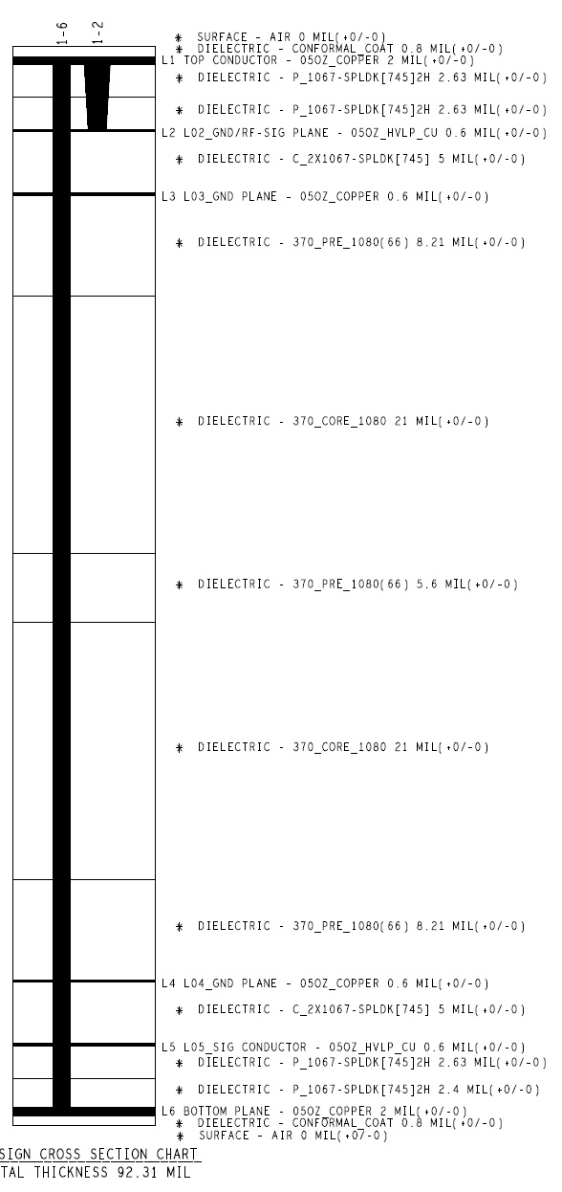
Xilinx XM500 Design

Slide 4
Arch1
CPLD
Digital IO
JTAG
ADC CLK1,2,3,4
LPAM
ADC Input
BALUN
LPAM
DAC Output
BALUN
DAC CLK1,2
Regulator
Digital IO

Slide 5
Arch2
Digital IO
JTAG
ADC CLK1,2,3,4
LPAM
ADC Input
BALUN
LPAM
DAC Output
BALUN
DAC CLK1,2
Regulator
Digital IO

Slide 6
DAC output Arch1
12V from RFMC
-has 80pins
-CPLD reamins data after powre down
-core 1.8V, logic 3.3V
JATG
CPLD
XC2C128-7VQG100I
regulator
7V
use IO port as a CPLD clock
1 digital pin
5 digital pins
TC2-72T+
Eliptical filter
PAT1220-C-9DB-T5
ERA-3SM+
RFMC
SMA
output
LPF
attenuator
-0~31.5dB
Amp
+23dB
(P1dB +13dBm)
T-pad
-9dB
balun
-0.5dB
RF SPDT
SMA
output
HMC545A
QPC7522
HSWA2-30DR+
DAT-31A-PP+
or total 13dB attenuator?

Slide 7
DAC output Arch2
reflection -> at least -27dB
12V from RFMC
regulator
Discrete Component
7V
TC2-72T+
Butterworth Filter
ERA-3SM+
RFMC
SMA
output
LPF
PA
+23dB
(P1dB +13dBm)
PI-pad
-13dB
balun
-0.5dB
RF SPDT
HMC545A
QPC7522
HSWA2-30DR+

Slide 8
DAC output Arch3
reflection -> at least -27dB
12V from RFMC
regulator
Discrete Component
7V
TCM2-33X+
LFCG-1000+
ERA-3SM+
RFMC
SMA
output
LPF
PA
+23dB
(P1dB +13dBm)
PI-pad
-13dB
balun
-0.5dB
RF SPDT
HMC545A
QPC7522
HSWA2-30DR+

Slide 9
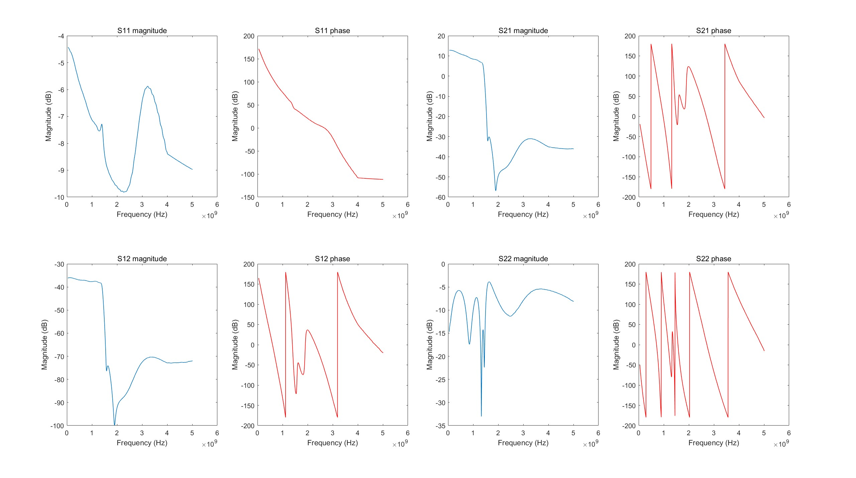
Without Attneuator, High S11 value

Slide 10
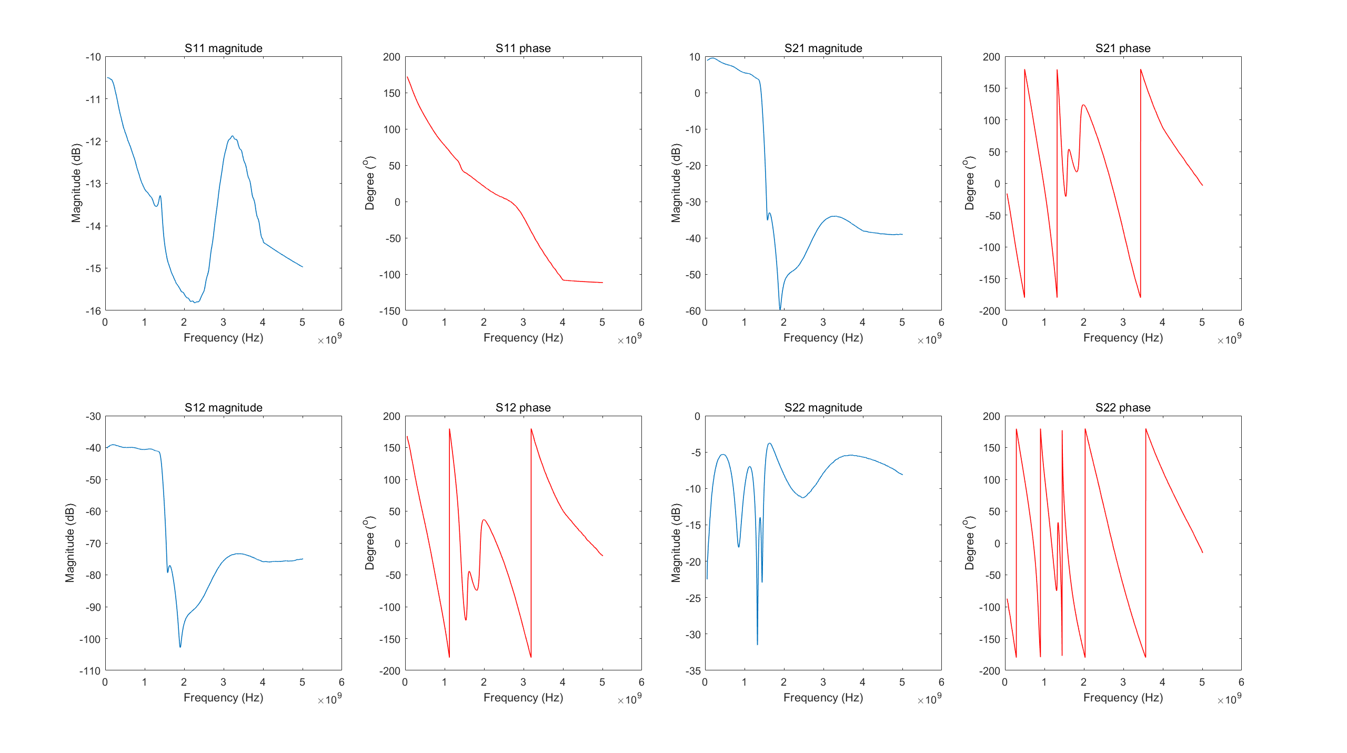
With Pi Attneuator, lower S11 value

Slide 11
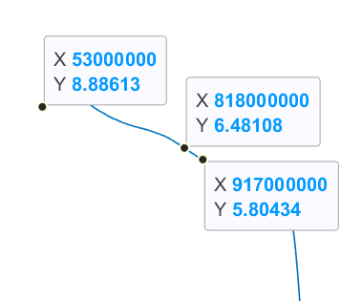
3dB Point near 800MHz

Slide 12
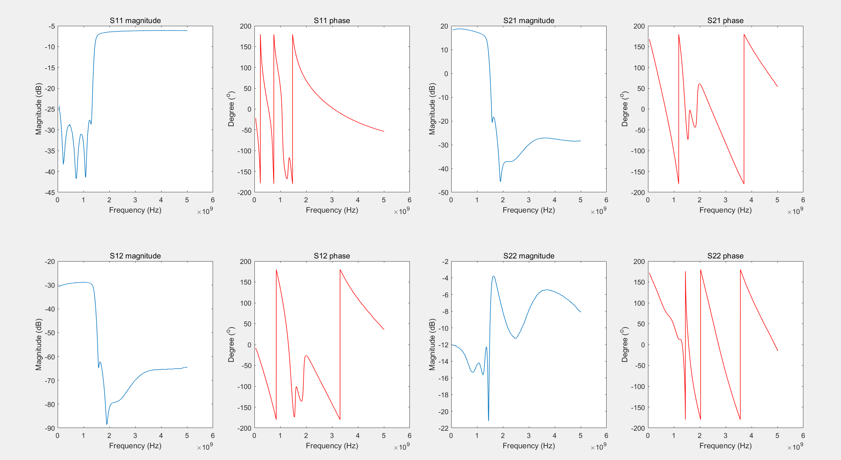
Without Balun...

Slide 13
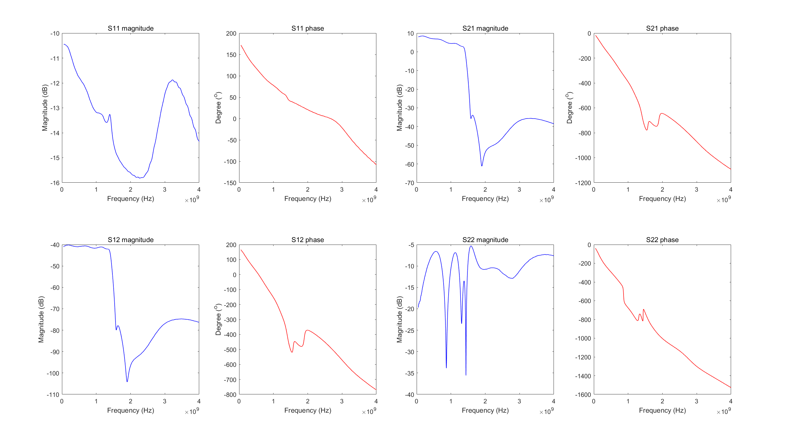
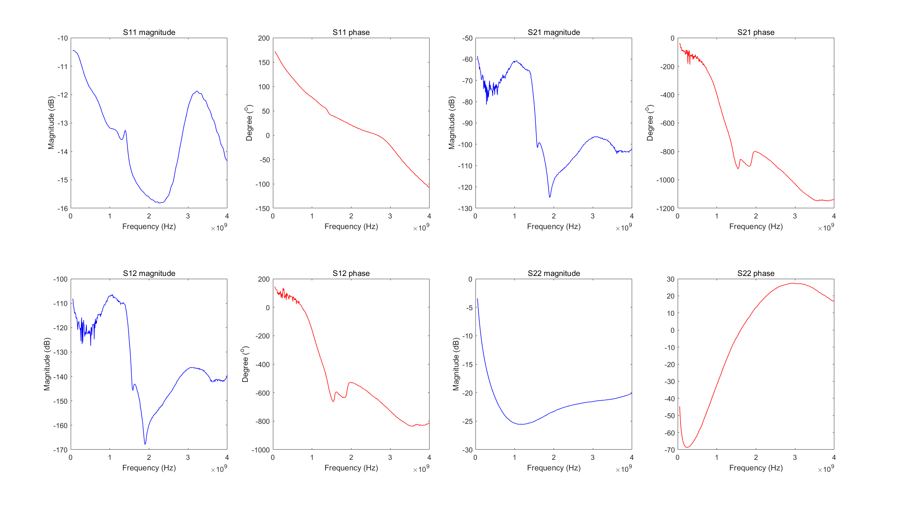

Slide 14
DAC output Arch4
S11 ~ -(6+6)dB
12V from RFMC
regulator
Discrete Component
7V
TCM2-33X+
LFCG-1000+
ERA-3SM+
RFMC
SMA
output
LPF
PA
+23dB
(P1dB +13dBm)
PI-pad
-3dB
balun
-10dB
RF SPDT
HMC545A
QPC7522
HSWA2-30DR+

Slide 15
LPF
PA
+23dB
(P1dB +13dBm)
PI-pad
-3dB
balun
-10dB

Slide 16
Regulator
12V0 -> 7V0
12V0 -> 5V0

Slide 17
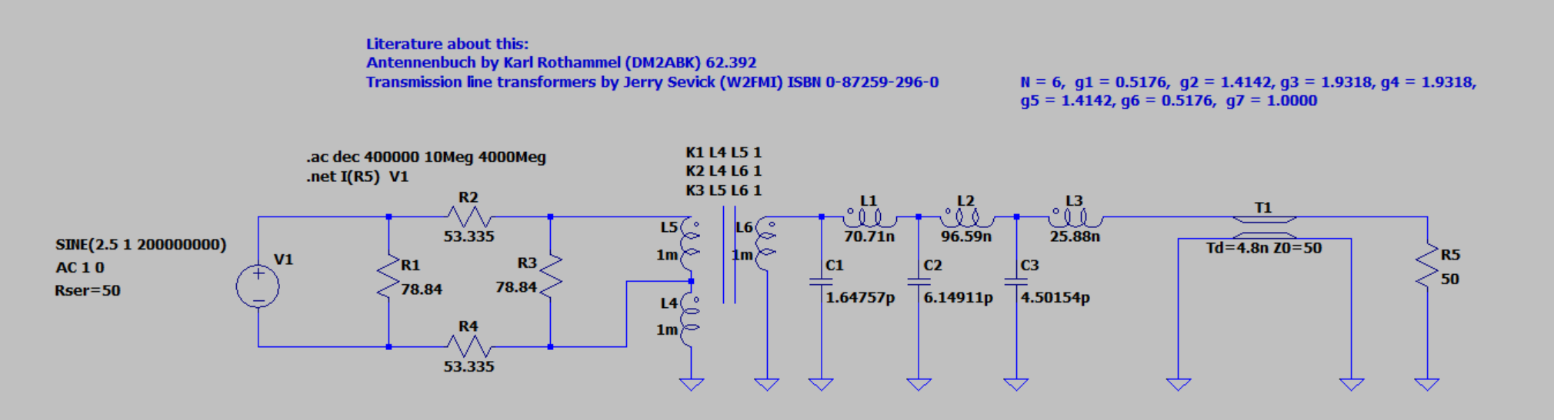
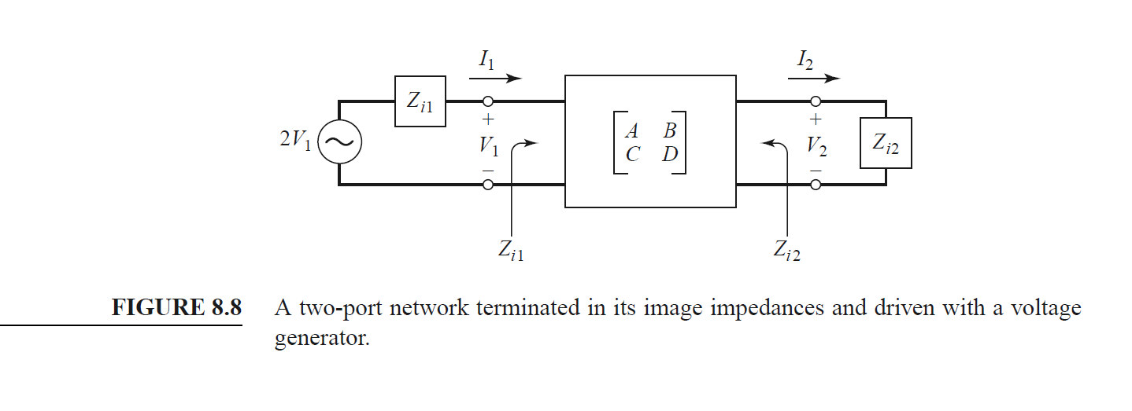
Circuit without AMP
cut off = 1GHz

Slide 18
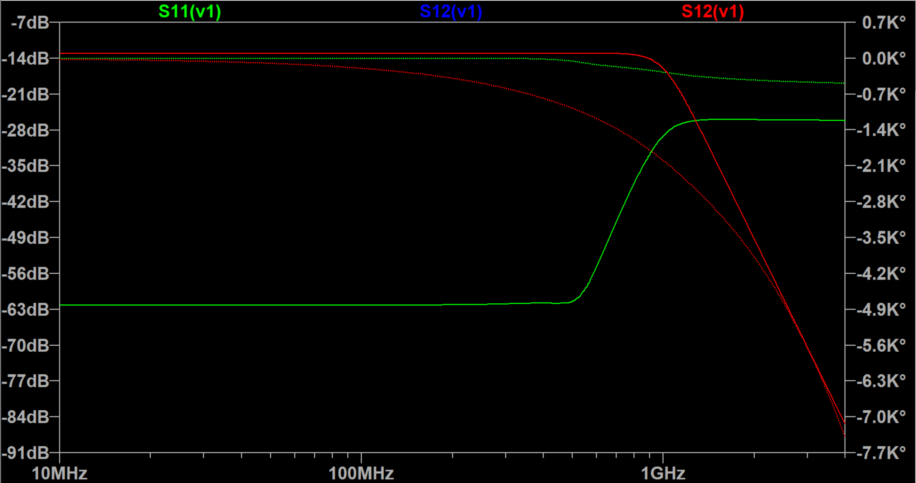
Circuit without AMP S Parameter(1)
cut off = 1GHz

Slide 19
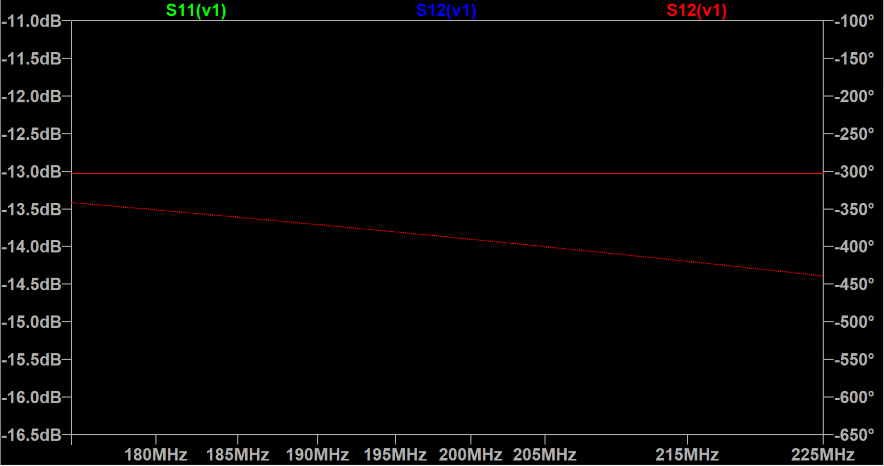
Circuit without AMP S Parameter(2)
cut off = 1GHz

Slide 20
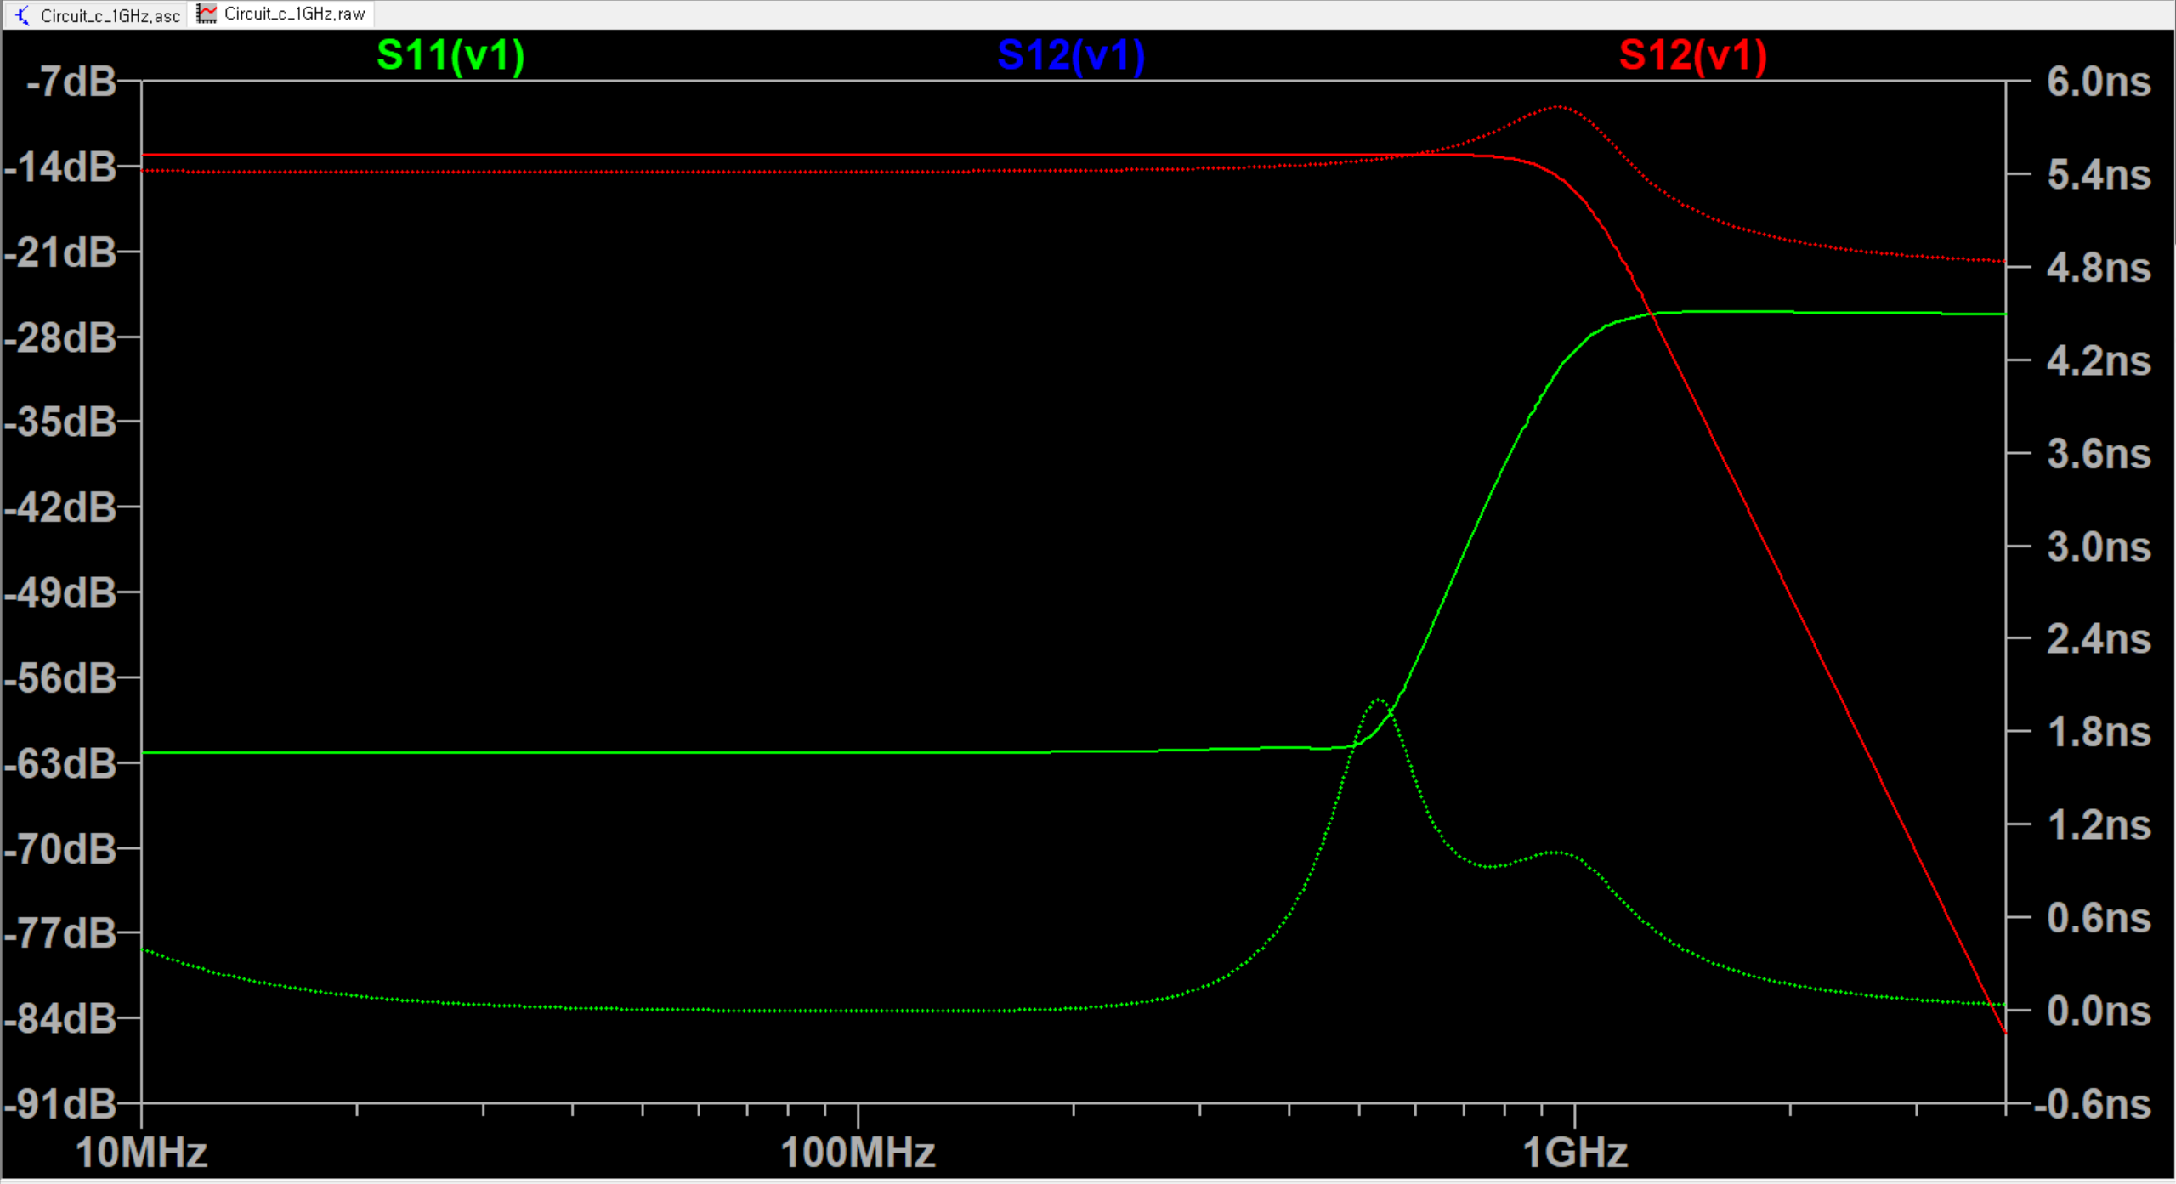
Circuit without AMP S Parameter(3)
cut off = 1GHz

Slide 21
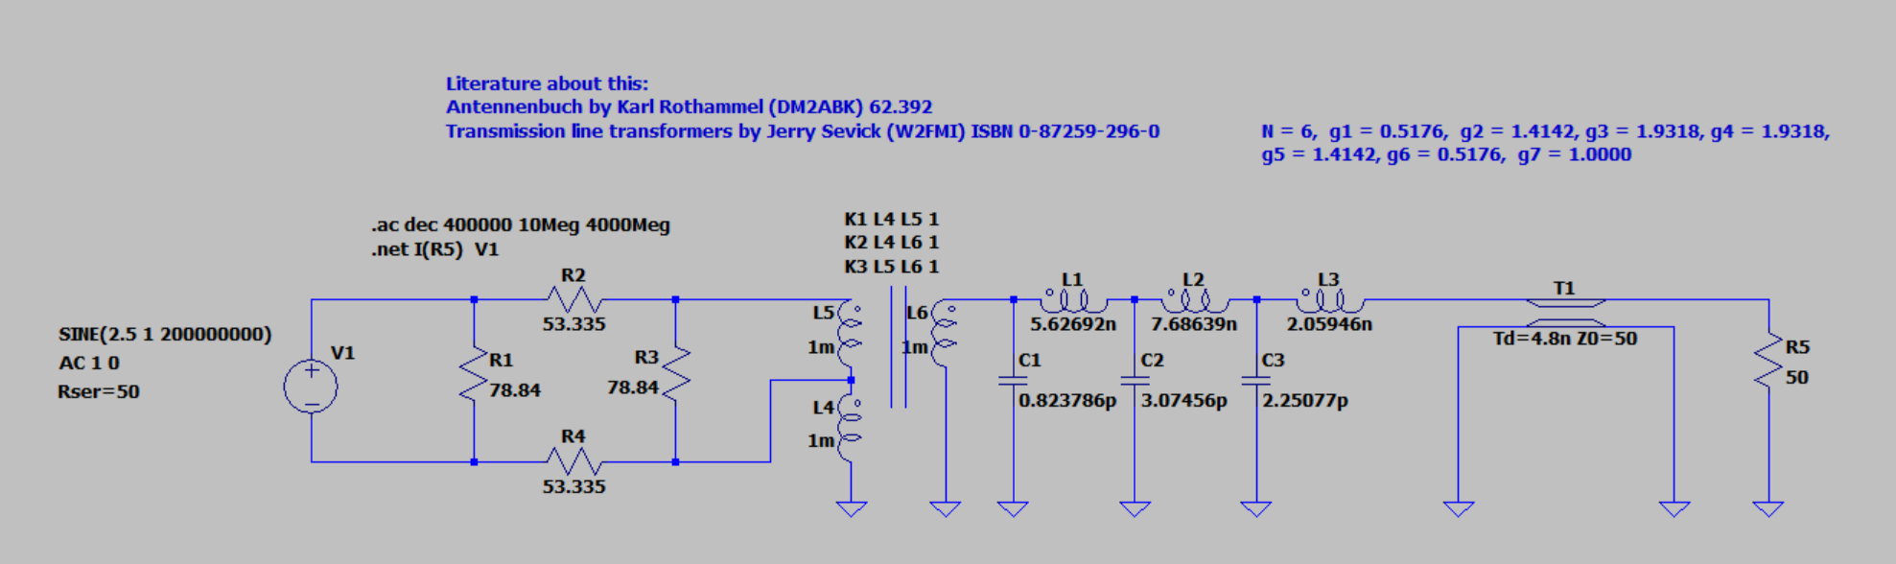
Circuit without AMP
cut off = 2GHz

Slide 22
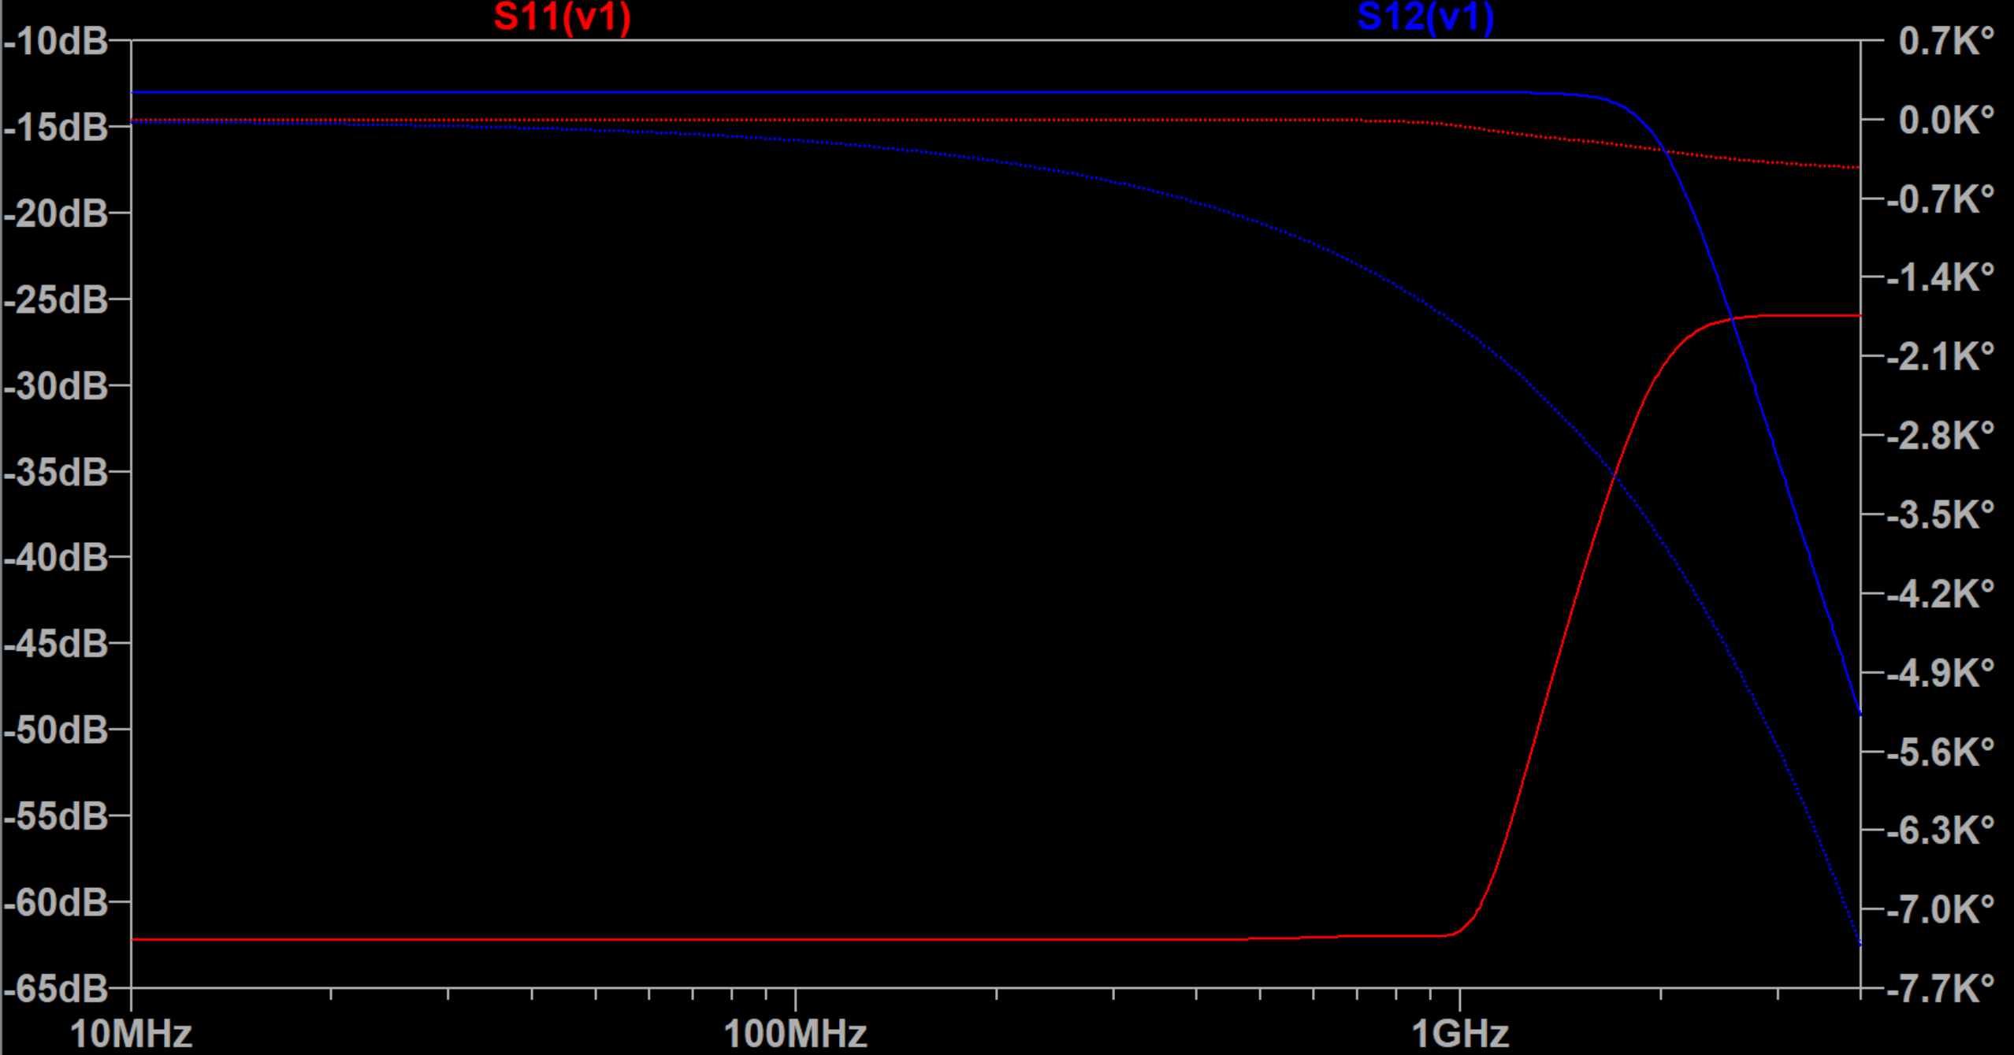
Circuit without AMP S Parameter(1)
cut off = 2GHz

Slide 23
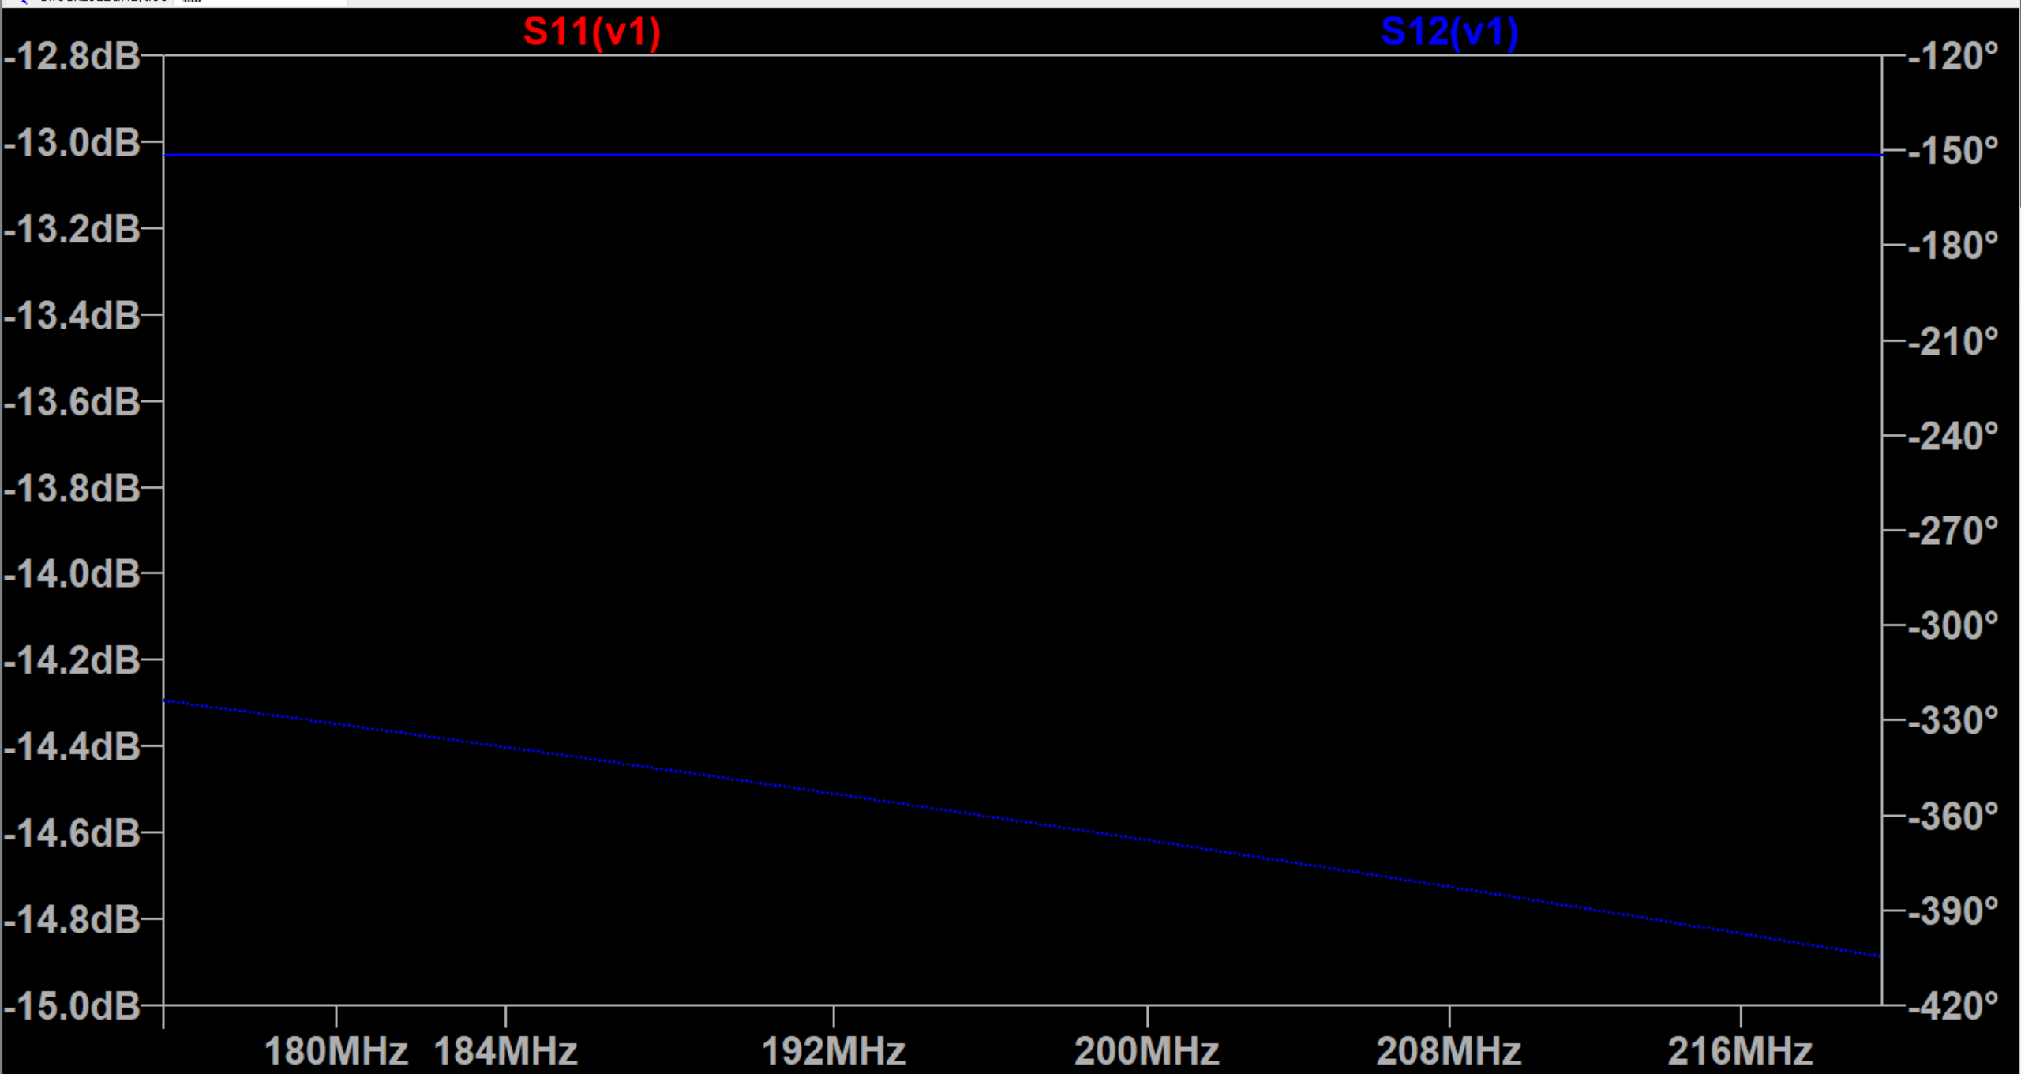
Circuit without AMP S Parameter(2)
cut off = 2GHz

Slide 24
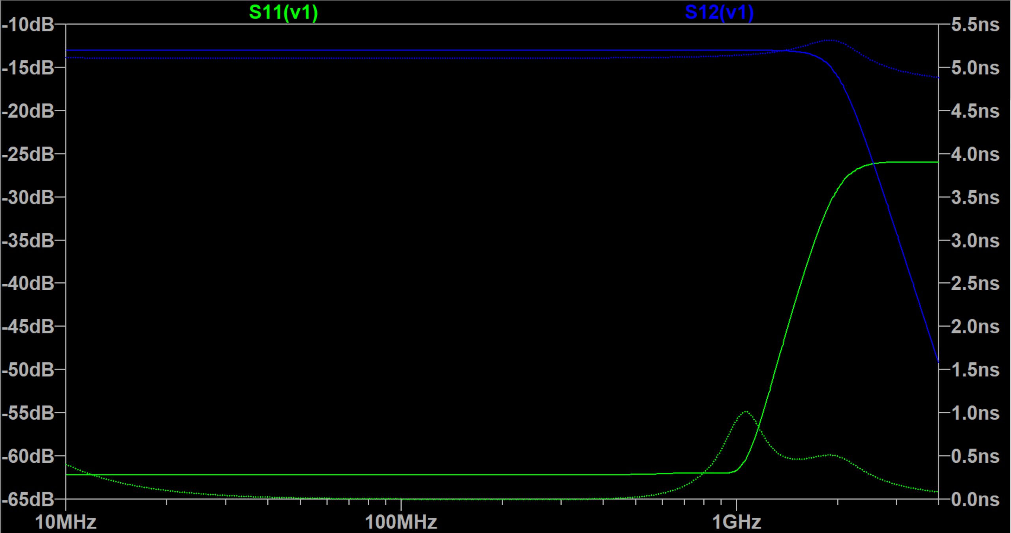
Circuit without AMP S Parameter(3)
cut off = 2GHz

Slide 25
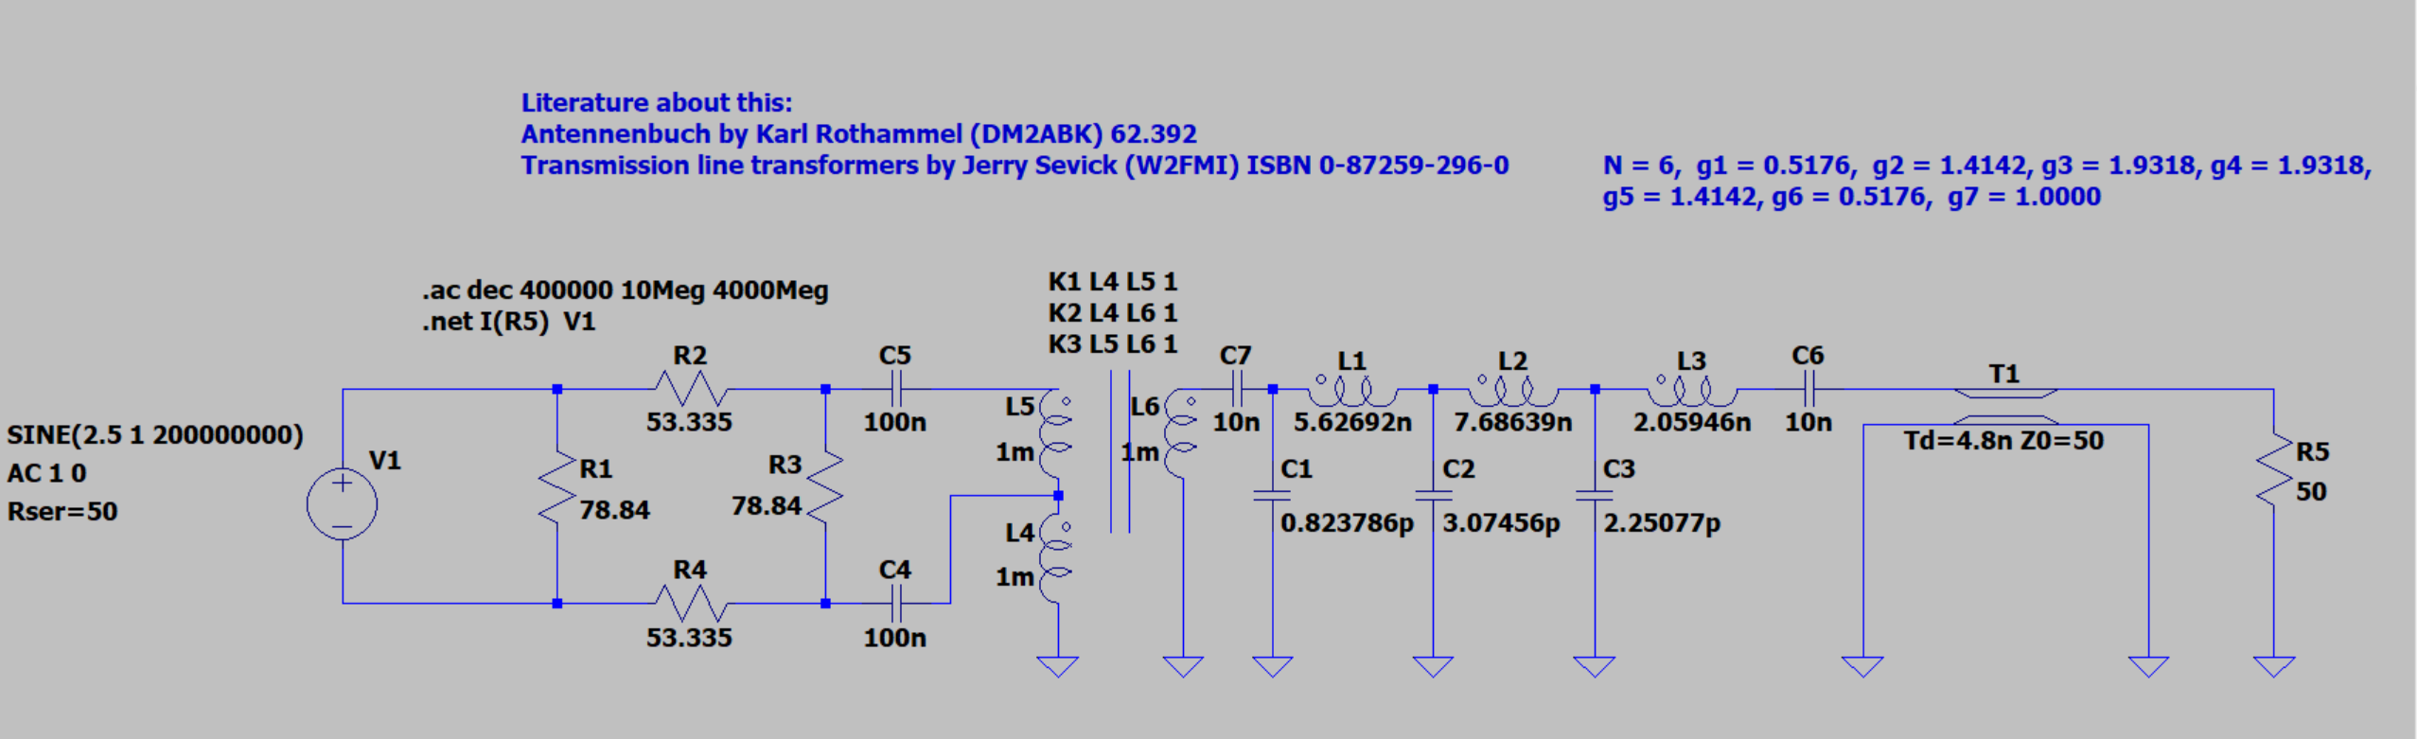
Final Design

Slide 26
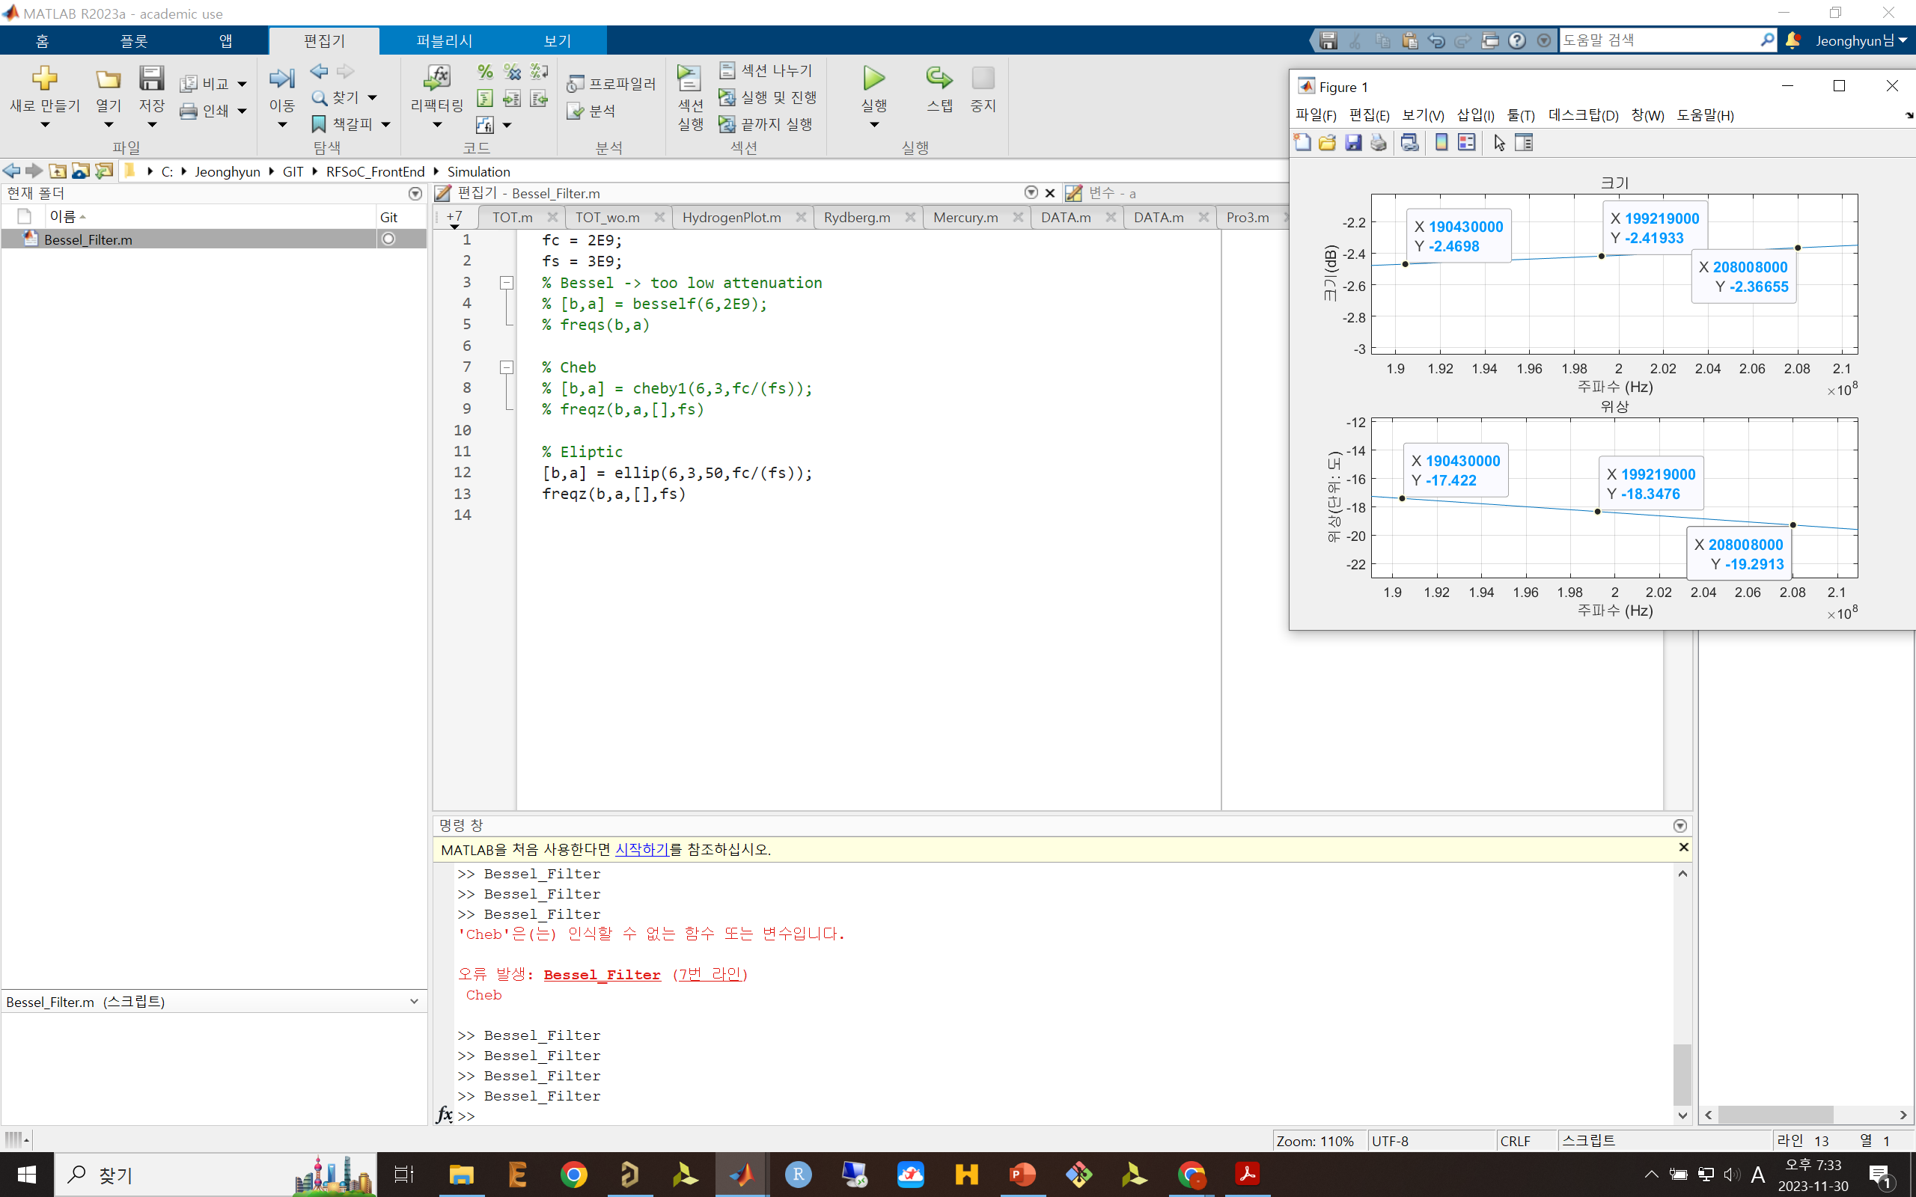
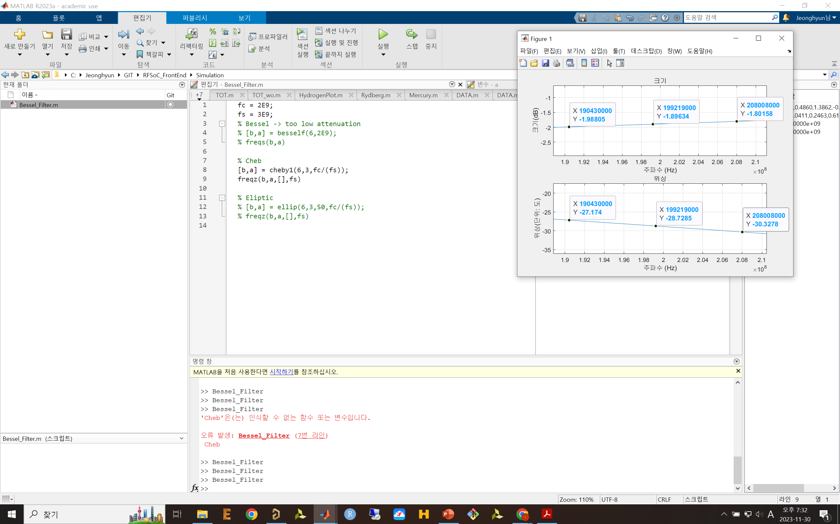
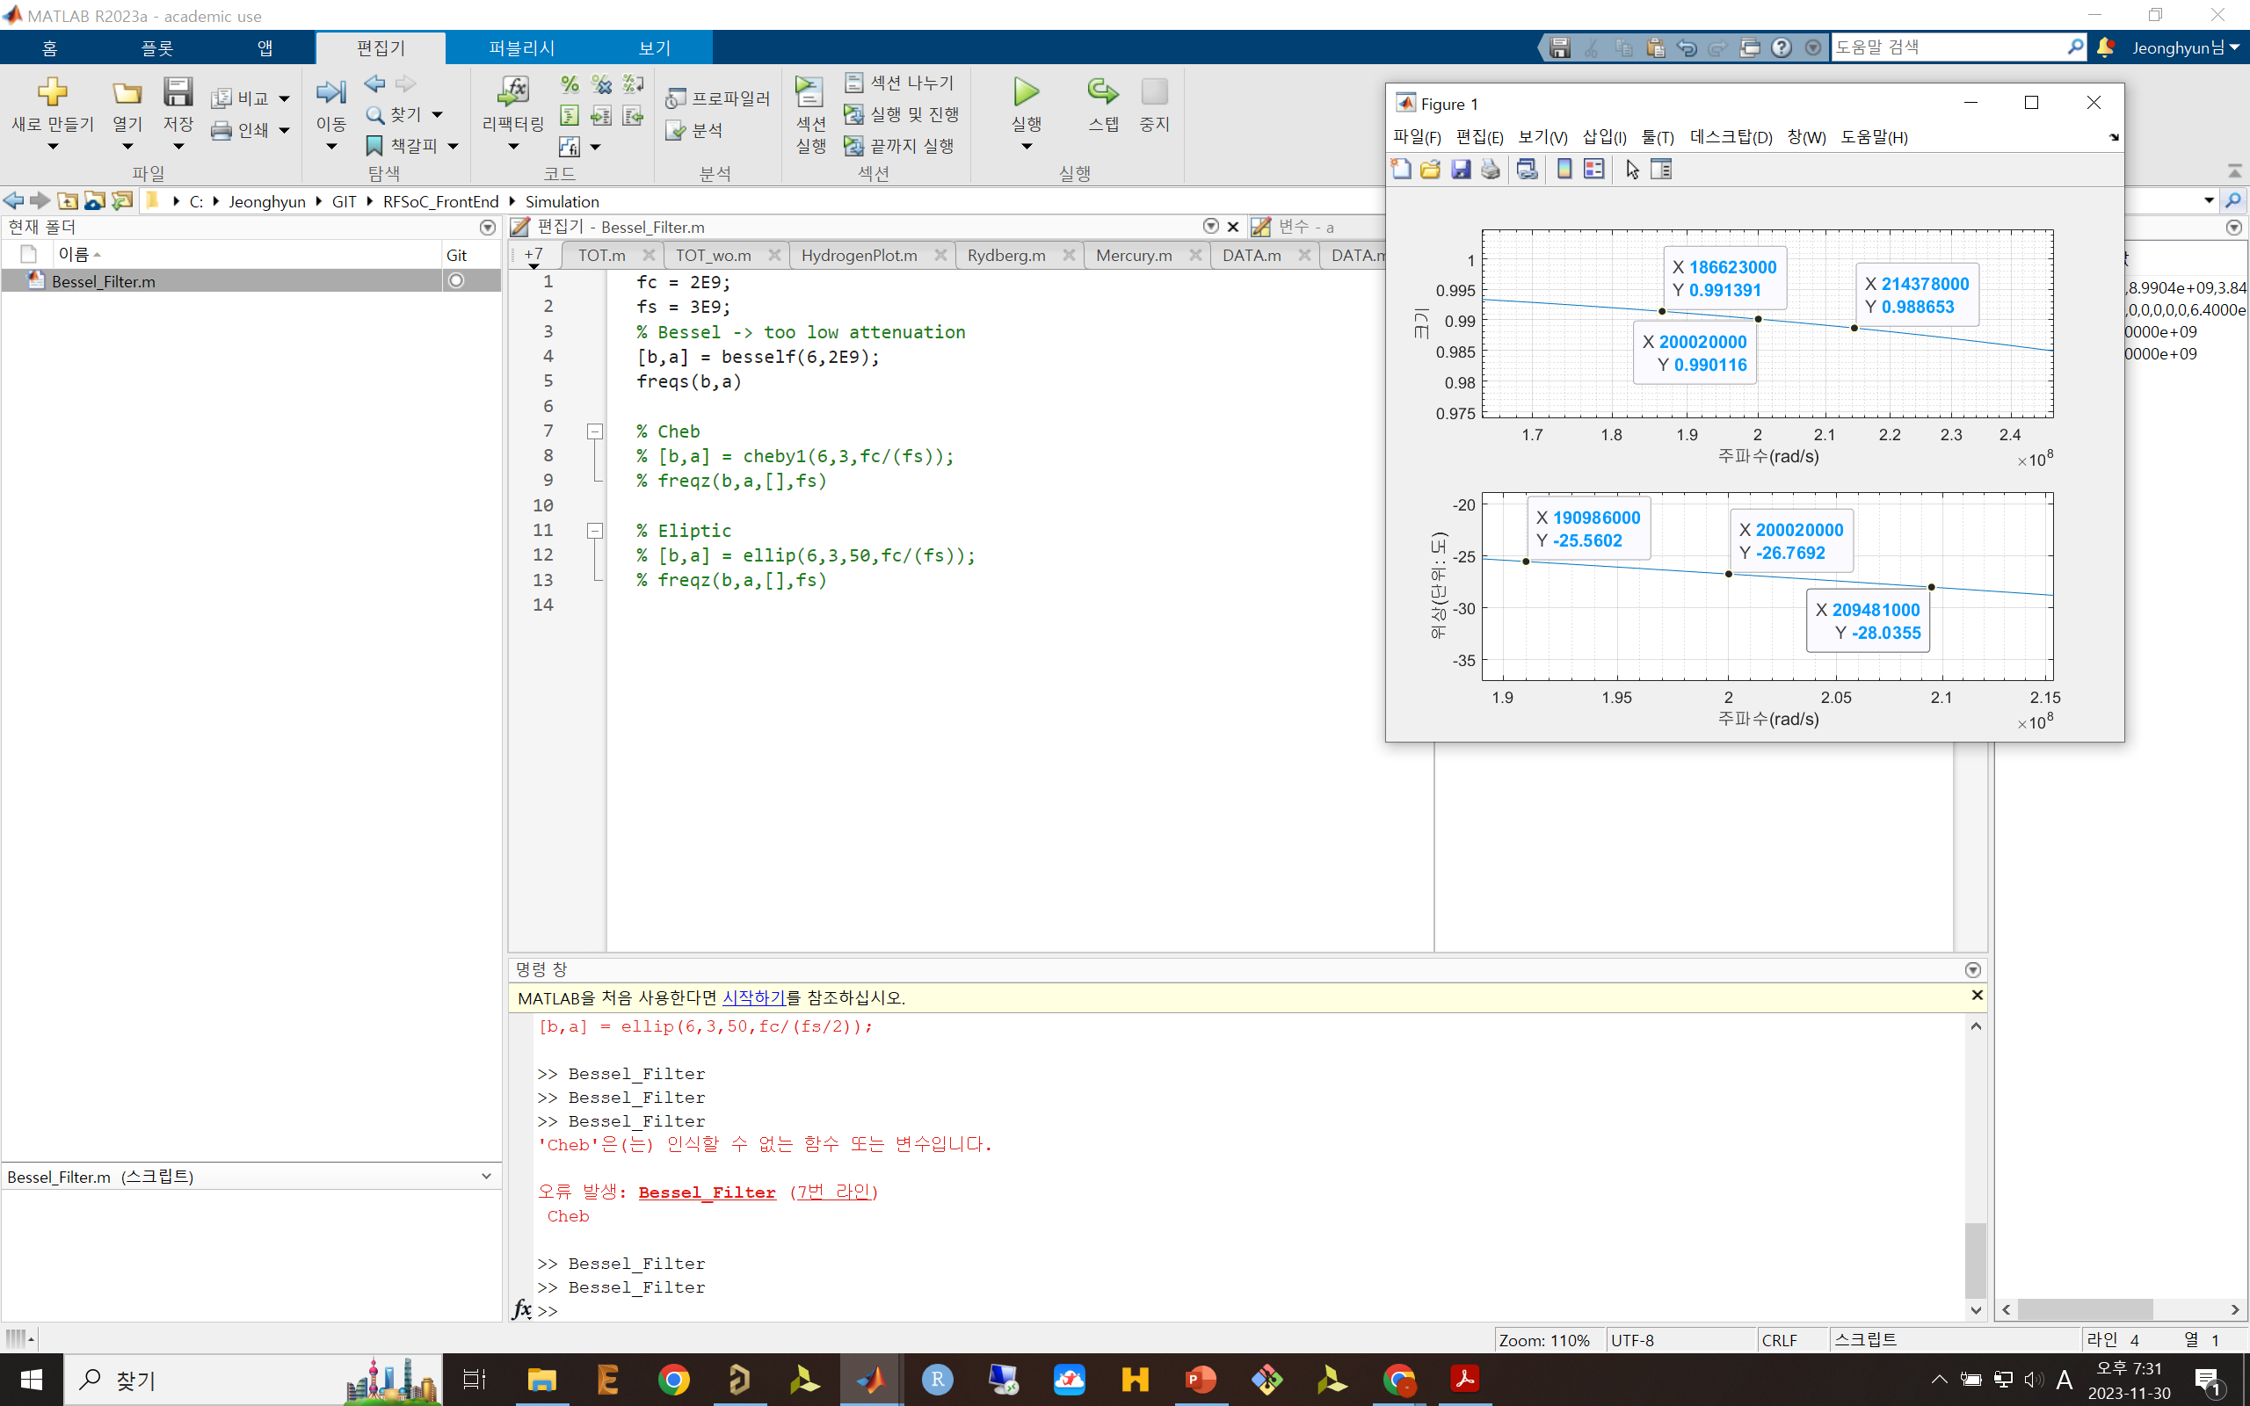
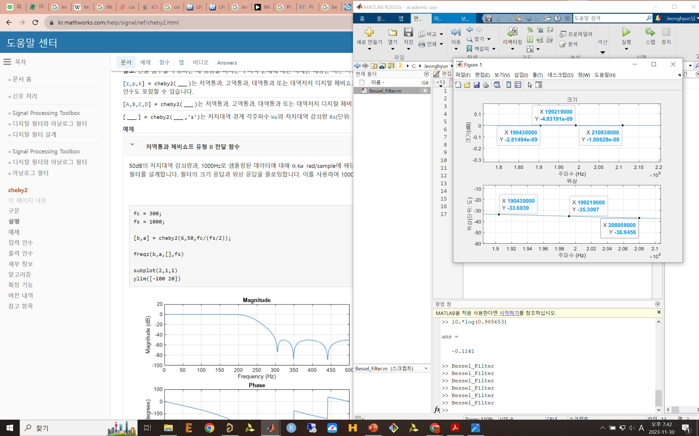

Slide 27
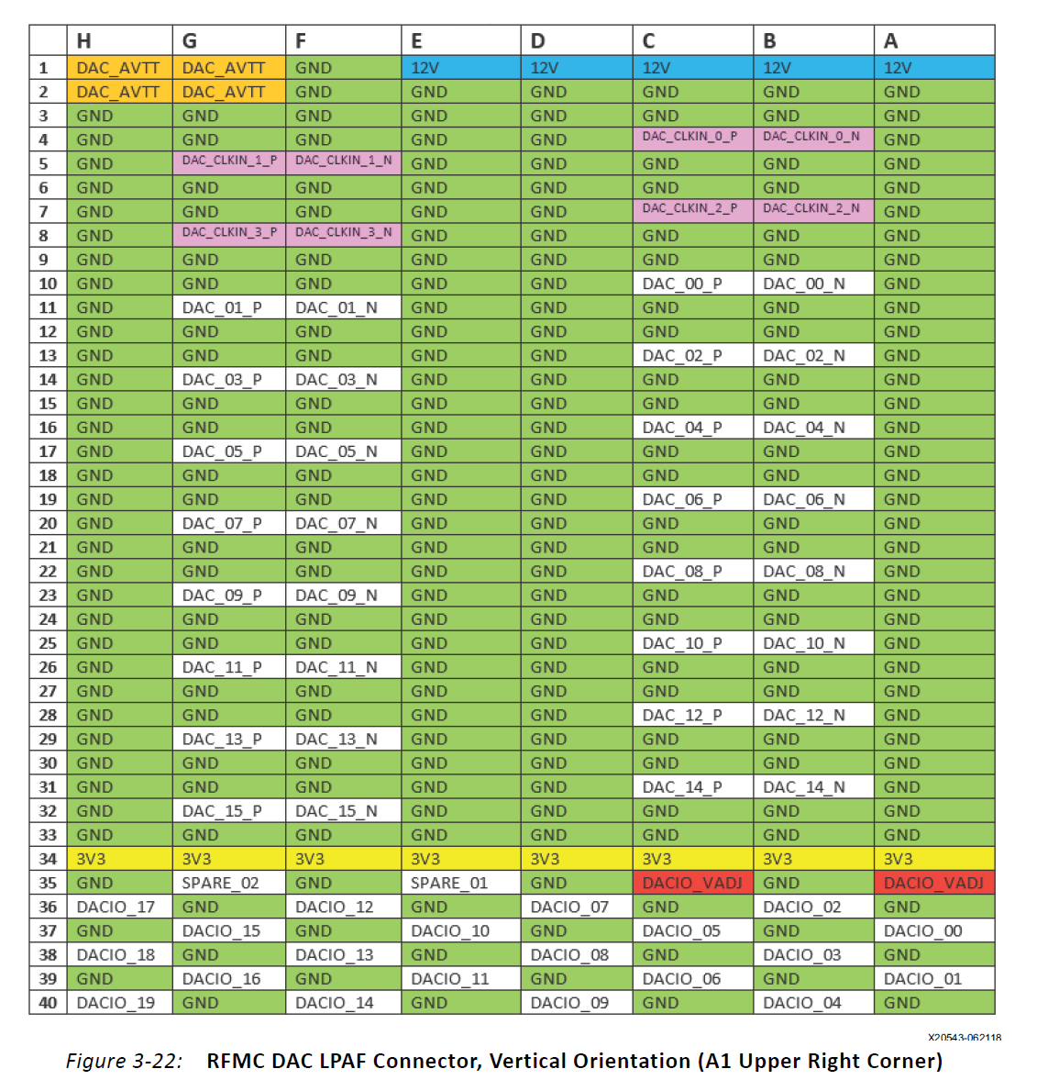
2.5V in 20mA
3.0V in 32mA
1.8V
8ns resolution

Slide 28
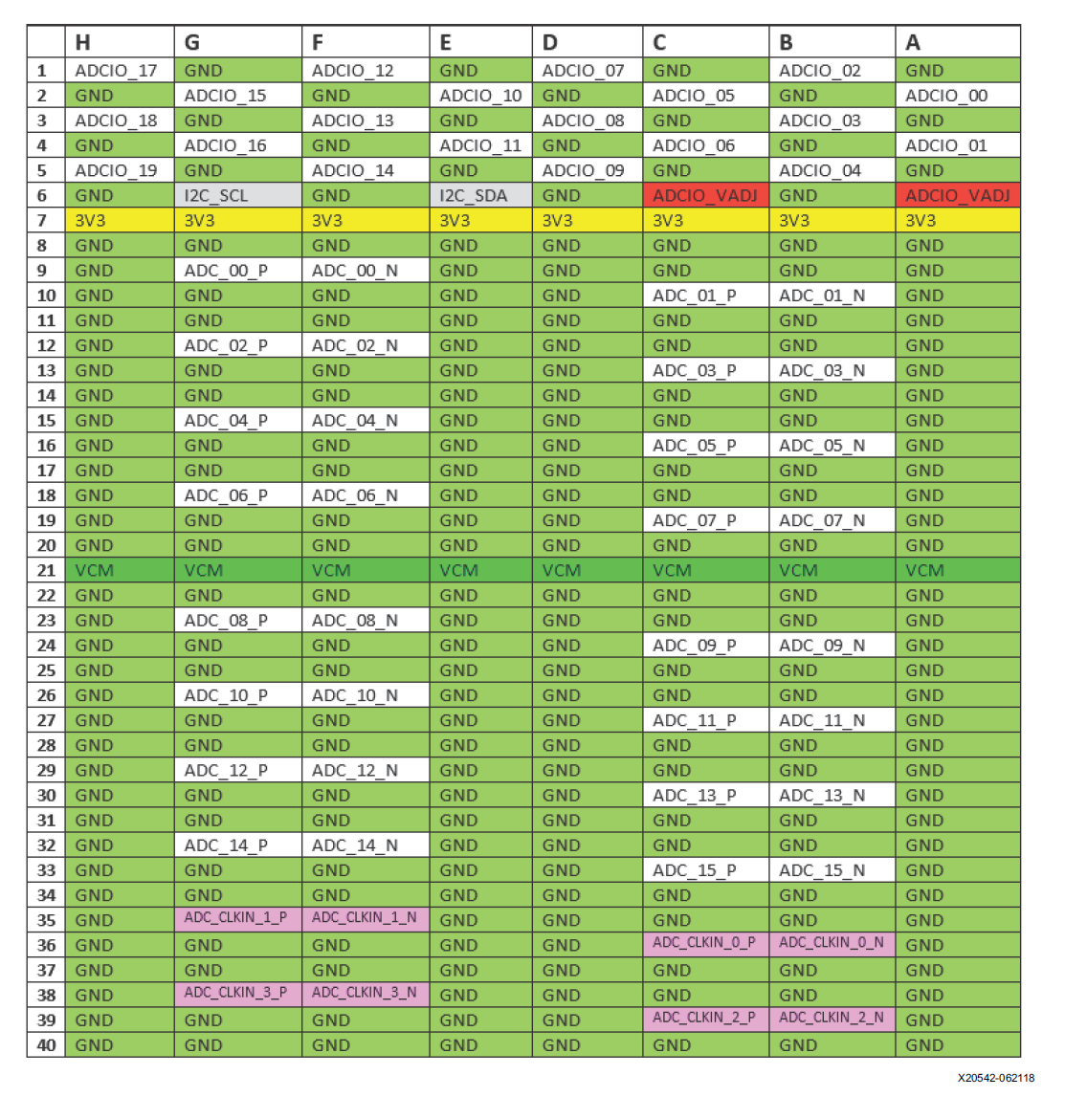

Slide 29
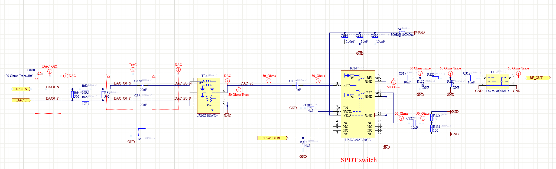
Artiq RFSoC SAWG
-No Amp, only a filter exists

Slide 30
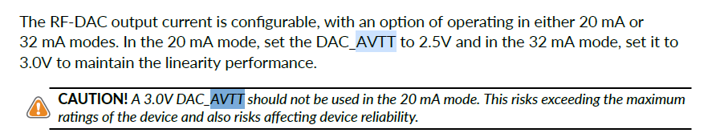
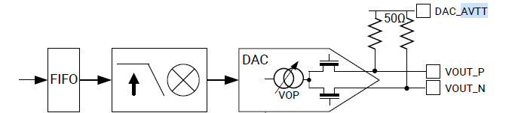
DAC_AVTT Connection
https://support.xilinx.com/s/question/0D54U00006MmmQaSAJ/zynq-ultrascale-rfsoc-zcu111-kit-rf-dac-output-current?language=en_US

Slide 31
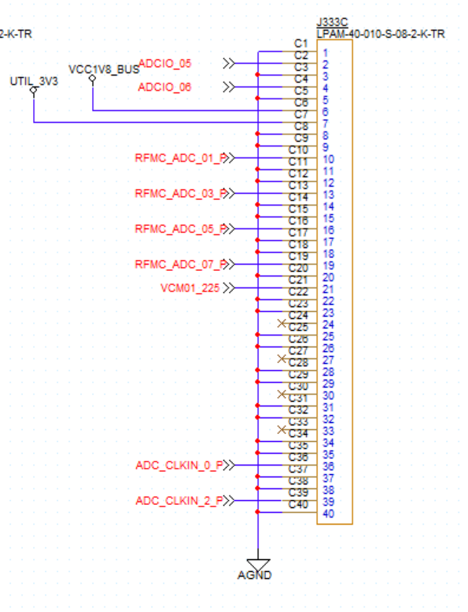
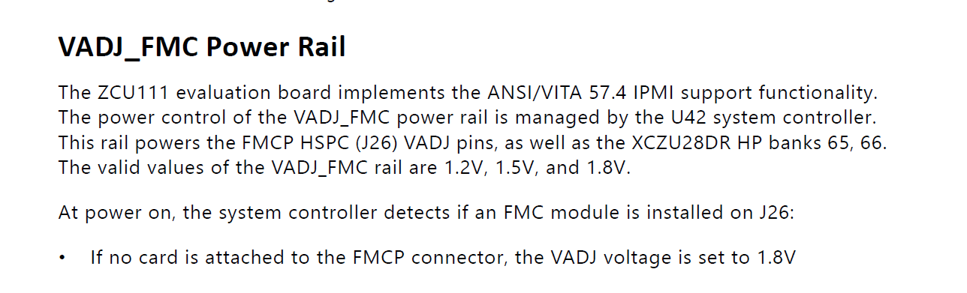
VADJ connection
Connect to 1.8V

Slide 32
step converter
LDO
12V
TPS62148RGXR
7.5V
7V
LT3045EDD
2A
500mA
7V
LT3045EDD
500mA
5V
LT1761ES5-BYP
100mA
3.3V
AP62201WU-7
2A

Slide 33
I2C1
TCA9548
PCF8574AT/3,518
ADDR
0x01

